Slide 1

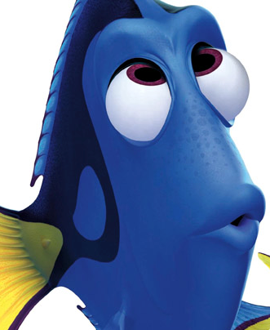


Strange Disorders
Presented by
Sushmitha U
Omg.. Am I an alien
oops.. Why did I do that
are they betraying me
Is he my real father
this is really bad

Slide 2
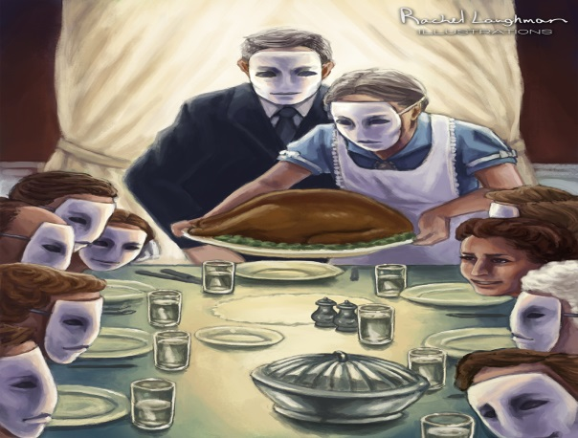
Capgras Syndrome
Delusional misidentification
Opposite of Deja-vu
Loved ones are replaced by doubles
Thought it was rare, but not
Joseph Capgras & Jean Reboul
Not like ‘face blindness’
Don’t have the feelings towards your loved ones
Head trauma, epilepsy
Similar is fregoli syndrome

Slide 3
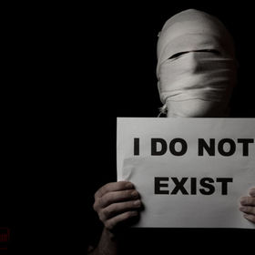
Cotard’s Syndrome
Denies the existence of one’s own body to the extend of immortality
Negation of existence
65 year old teacher – nihilistic delusion
Common in females older than 60
Refuses to take treatment
Imagine themselves in heaven or hell

Slide 4

Todd’s Syndrome
Alice in Wonderland syndrome
Affects children
Altered perception of the shapes of animate and inanimate objects
Impaired sense of passage of time
Feeling of ‘zooming’ of the environment
No damaged eye-sight or brain tumours
Majority patients are victims of migraine

Slide 5
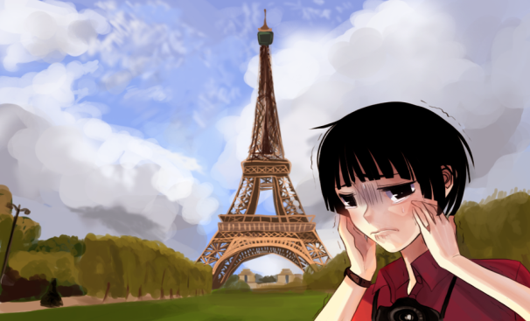
Paris Syndrome
Caused by disappointment of over romanticized expectation of Paris as city of love
Experienced by Japanese tourists mostly
cities such as Tokyo are filled with French patisseries and luxury French fashion outlets such as Chanel and Louis Vuitton
Around six million Japanese people visit France each year
Fix is take a flight and return home

Slide 6
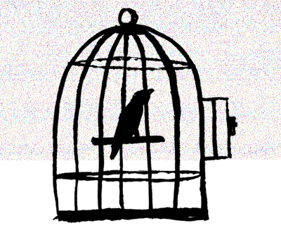
Stockholm Syndrome
Occurs in captive or hostage situation
Robbery in Stockholm, Sweden, August 1973
Complex reaction frightening situation
Hostages develop negative feeling about the police
Develop positive feeling about the captors
Over 1200 8% develop SS
Crisis lasts longer, hostages in contact with captors, captors are kind
Opposite is Lima syndrome

Slide 7
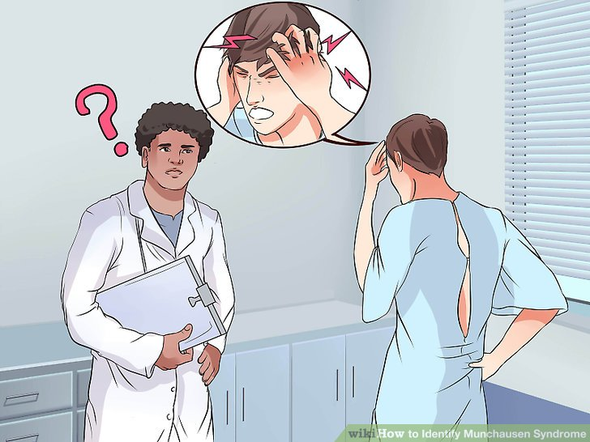
Munchausen Syndrome
A person repeatedly and deliberately acts as if he or she has a physical or mental illness when he or she is not really sick
They may lie about or fake symptoms, hurt themselves to bring on symptoms, or alter tests
Reluctance by the patient to allow doctors to meet with or talk to family, friends, or prior doctors
Extensive knowledge of hospitals
history of abuse or neglect as a child, or a history of frequent illnesses

Slide 8
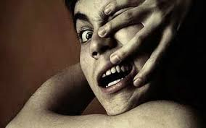
Alien Hand’s Syndrome
Attacked by your own hands
Happens after a brain surgery or stroke
Under the control of alien intelligence
You decide to turn left but you turn right
Karen Byrne 55 year old
Surgery to cure epilepsy
Ended in alien hand syndrome
Caused by power struggle going on inside her head

Slide 9

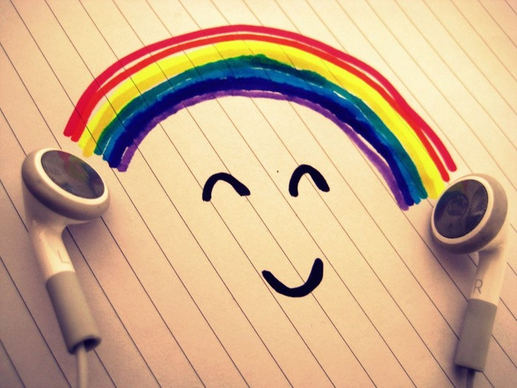
Thank you
Happy life with no disorders ☺

